Slide 1
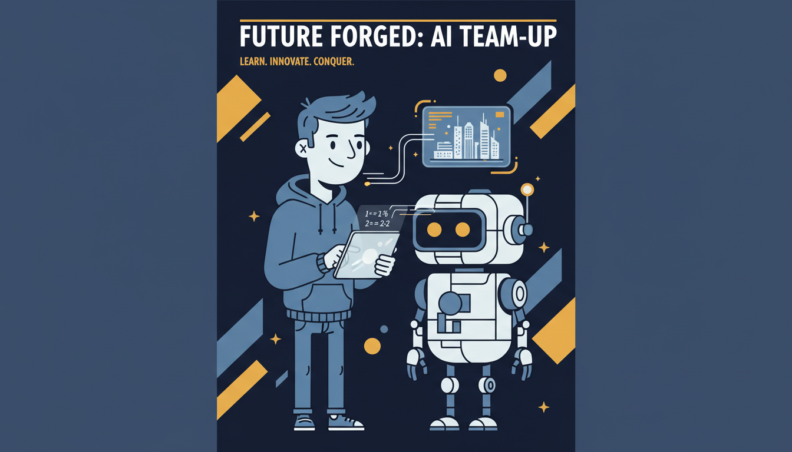
Using AI Tools:
Pros and Cons
How AI helps us — and where it can cause problems

Slide 2

What are AI tools?
AI tools are software programs that use artificial intelligence to perform tasks that typically require human intelligence.
Common examples:
Chatbots — answer questions and have conversations
Image generators — create artwork from text descriptions
Recommendation systems — suggest videos, music, products

Slide 3
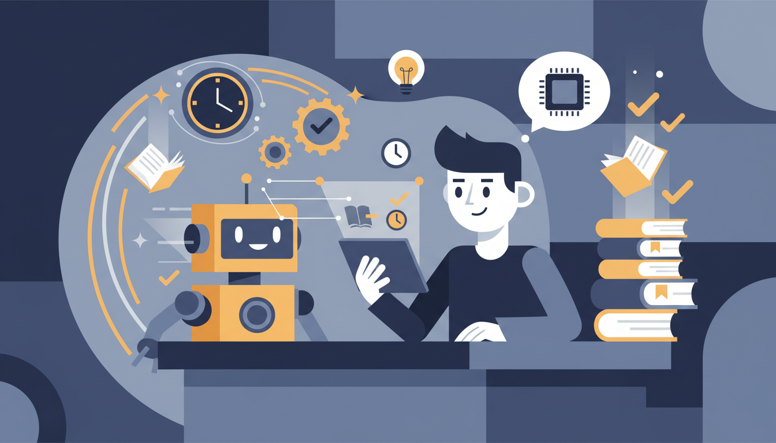
Pros of using AI tools
Saves time
AI can complete tasks in seconds that would take humans hours — like summarizing long documents or organizing data.
Helps with learning and work
AI tutors can explain difficult concepts, help with writing, and provide practice exercises tailored to your level.
Automates routine tasks
Repetitive jobs like scheduling, sorting emails, or formatting documents can be handled automatically.

Slide 4
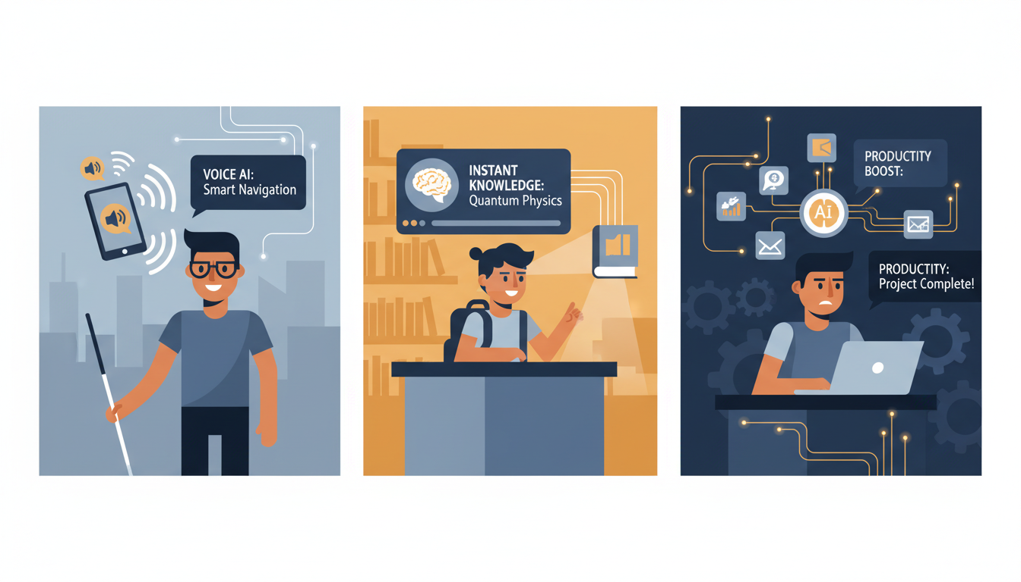
More benefits
Improves productivity
By handling repetitive tasks, AI frees up time for creative and strategic work that humans do best.
Quick access to information
AI can search through millions of sources instantly and present relevant information in an organized way.
Helps people with disabilities
Voice assistants, real-time captions, and text-to-speech tools make technology accessible to everyone.

Slide 5
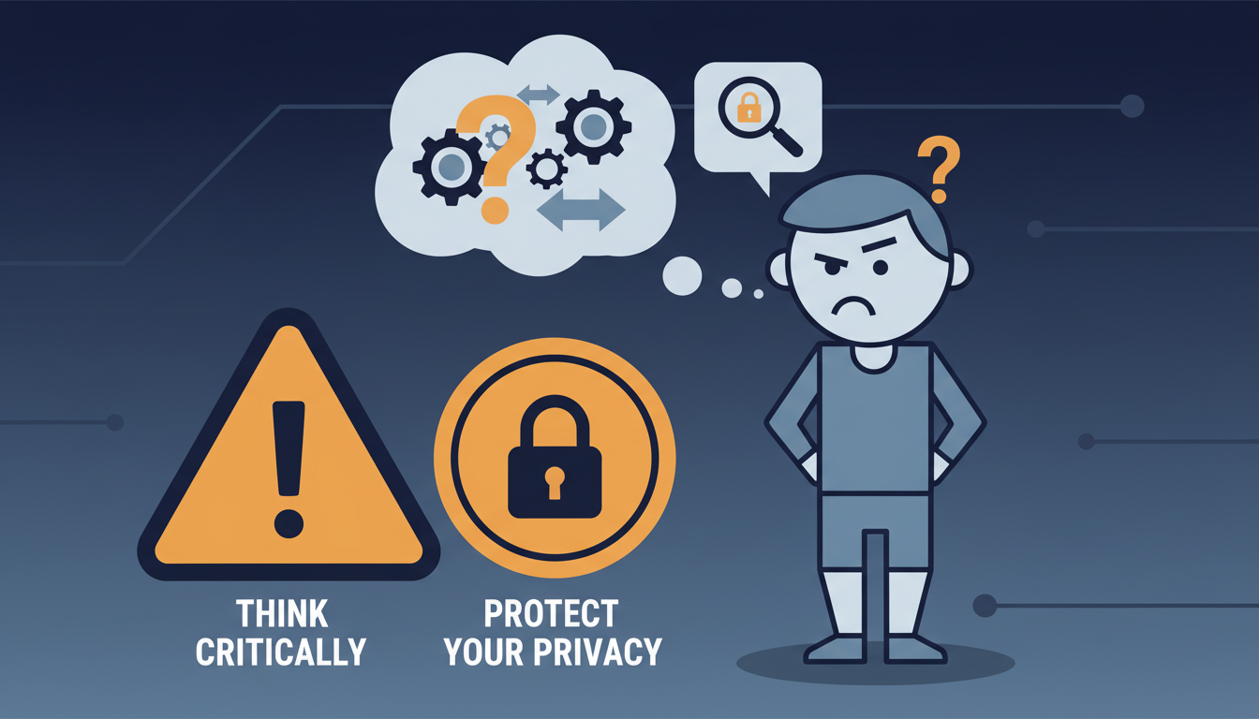
Cons of using AI tools
Can give incorrect information
AI sometimes "hallucinates" — making up facts, sources, or data that sound convincing but are completely wrong.
Over-reliance reduces critical thinking
Depending too much on AI can weaken problem-solving skills and independent thinking abilities.
Privacy and data risks
AI systems collect and store user data, which can be vulnerable to breaches or misuse.

Slide 6
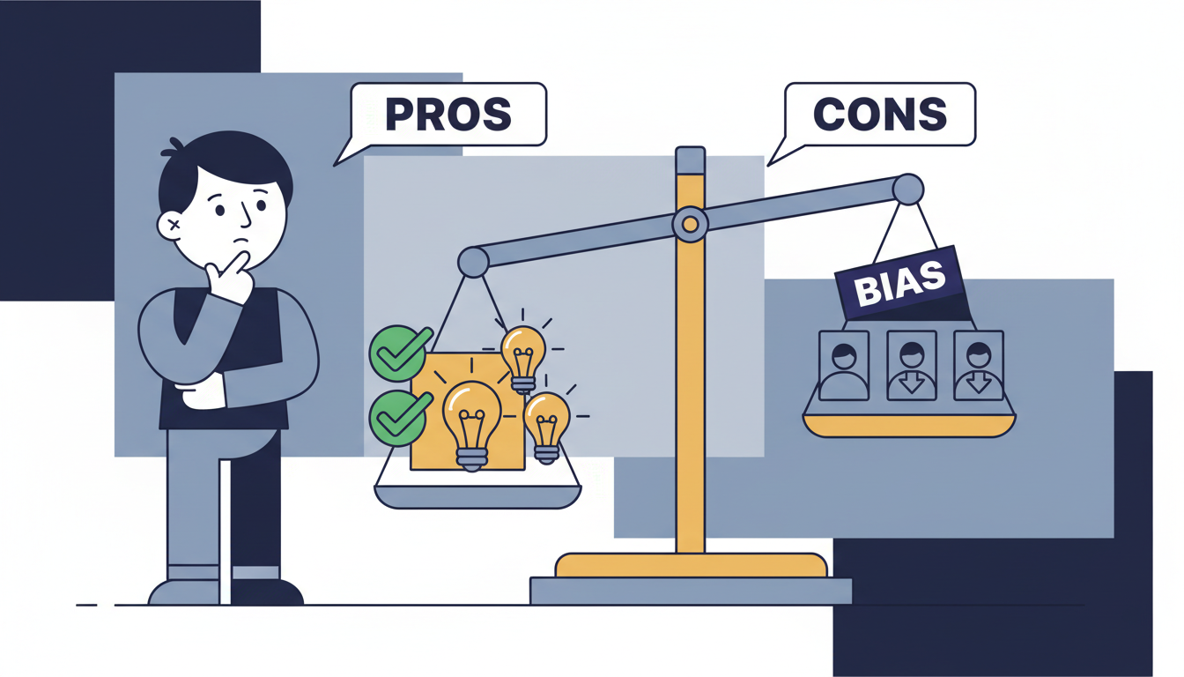
Ethical and social concerns
Bias in AI decisions
AI systems can reflect and amplify human biases found in their training data, leading to unfair outcomes in hiring, lending, and law enforcement.
Job displacement
Automation powered by AI may eliminate certain jobs, requiring workers to learn new skills and adapt to changing industries.
Responsible use is required
Using AI ethically means understanding its limitations, verifying information, and considering the impact on others.

Slide 7
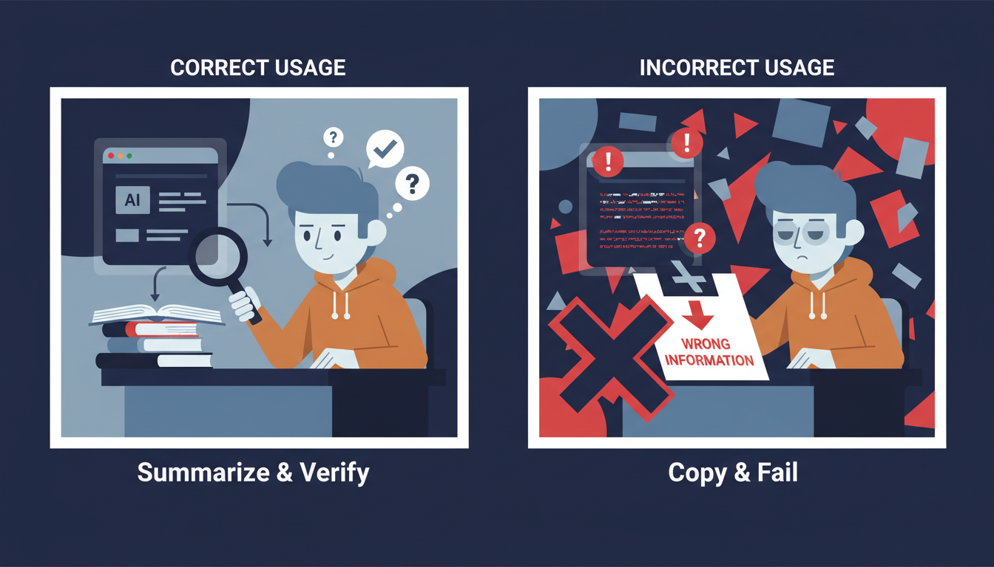
Real-life example
✓ Smart approach: Maria's study method
Maria uses AI to summarize long articles and generate study questions. But she always checks facts against her textbooks and thinks critically about the AI's suggestions. Result: Better understanding, higher grades.
✗ Risky approach: Tom's shortcut
Tom copies AI-generated content directly for his essay without checking. The AI included made-up statistics and fictional sources. Result: Failed assignment, academic warning.
Lesson: AI helps, but you must stay in control.

Slide 8
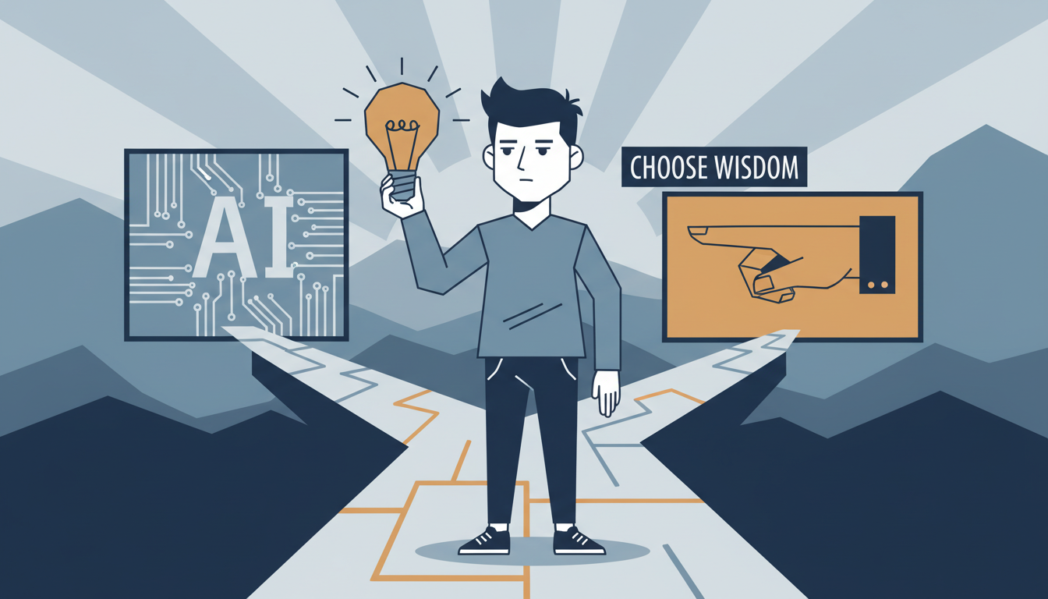
The key takeaway
AI is a tool, not a replacement for thinking.
Benefits are real. Risks are real.
Smart and ethical use is the key.
"Use AI to enhance your abilities, not replace your judgment."

